Slide 1
Python Programming
Session 4: (Object-Oriented Programming (OOP))

Slide 2
Agenda:
1 | Introduction to OOP Concepts
2 | Defining Classes and Creating Objects
3 | Practical Examples

Slide 3
Introduction to OOP Concepts

Slide 4
Introduction to OOP Concepts
Object-Oriented Programming (OOP) is a programming paradigm based on the concept of "objects" that can contain data and methods to manipulate that data. This session covers the fundamental concepts of OOP, defining classes and creating objects, followed by practical examples.

Slide 5
Introduction to OOP Concepts
Key OOP Concepts
Classes: A class is a blueprint for creating objects. It defines the attributes (data) and methods (functions) that the objects created from the class will have.
Objects: An object is an instance of a class. It represents a specific example of the class with actual data and behavior.
Attributes: Attributes are variables that belong to a class. They define the properties or state of an object.
Methods: Methods are functions defined within a class that describe the behaviors or actions of the objects created from the class.

Slide 6
Defining Classes and Creating Objects

Slide 7
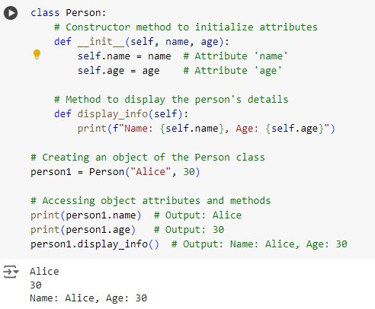
Defining Classes and Creating Objects
Basic Class and Object Creation
Class Definition: class Person: defines a class named Person.
Constructor Method: __init__(self, name, age) initializes the object's attributes (name and age) when a new Person object is created.
Method: display_info() is a method that prints the object's name and age.
Object Creation: person1 = Person("Alice", 30) creates a new Person object named person1 with the name "Alice" and age 30.

Slide 8
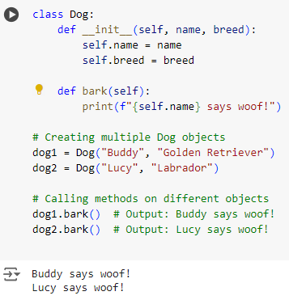
Defining Classes and Creating Objects
Using Multiple Objects
Class Definition: class Dog: defines a class named Dog.
Attributes: name and breed are initialized in the constructor.
Method: bark() is a method that prints a message using the object's name.
Multiple Objects: dog1 and dog2 are different instances of the Dog class, each with its own name and breed.

Slide 9
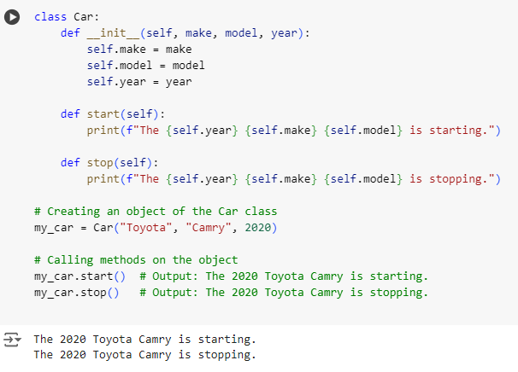
Defining Classes and Creating Objects
Adding Behavior with Methods
Class Definition: class Car: defines a class named Car.
Attributes: make, model, and year are initialized in the constructor.
Methods: start() and stop() provide behavior for starting and stopping the car.
Object Creation: my_car = Car("Toyota", "Camry", 2020) creates a Car object with specific details.

Slide 10
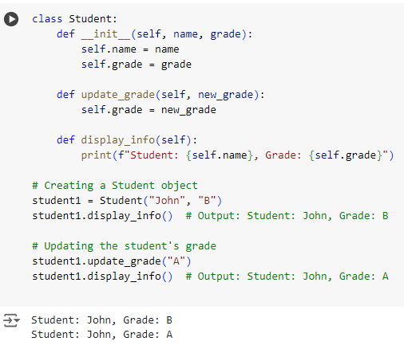
Defining Classes and Creating Objects
Updating Object Attributes
Method to Update Attributes: update_grade(self, new_grade) changes the object's grade attribute.
Object Creation: student1 = Student("John", "B") creates a Student object.
Updating Attributes: The update_grade() method is called to change the student's grade.

Slide 11
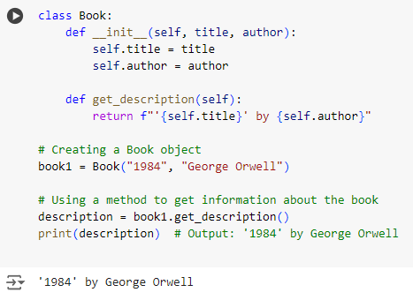
Defining Classes and Creating Objects
Using a Method to Return Information
Method Returning Information: get_description(self) returns a formatted string containing the book's title and author.
Object Creation: book1 = Book("1984", "George Orwell") creates a Book object.
Calling Method: The get_description() method is called to get a string describing the book.

Slide 12
Summary
Classes and Objects: Classes define the blueprint for objects, and objects are instances of classes.
Attributes and Methods: Attributes store the state of an object, and methods define the behavior of an object.
Creating Objects: Objects are created using the class name followed by parentheses, which call the class constructor.
Accessing Methods and Attributes: Use dot notation (object.method() or object.attribute) to call methods and access or modify attributes.

Slide 13
Practical Examples

Slide 14
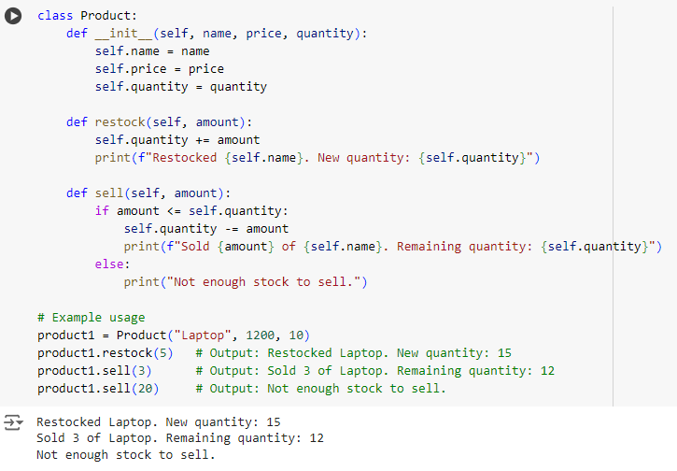
Managing a Simple Inventory System
The Product class models a product in an inventory system, with attributes for name, price, and quantity. It includes methods to restock and sell the product, which update the quantity accordingly.

Slide 15
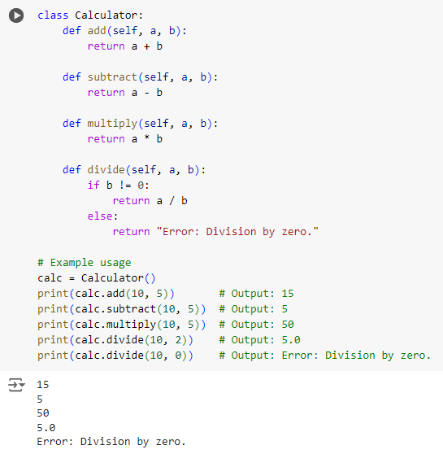
Simple Calculator Class
The Calculator class defines methods for basic arithmetic operations: add, subtract, multiply, and divide. It checks for division by zero to prevent errors.

Slide 16
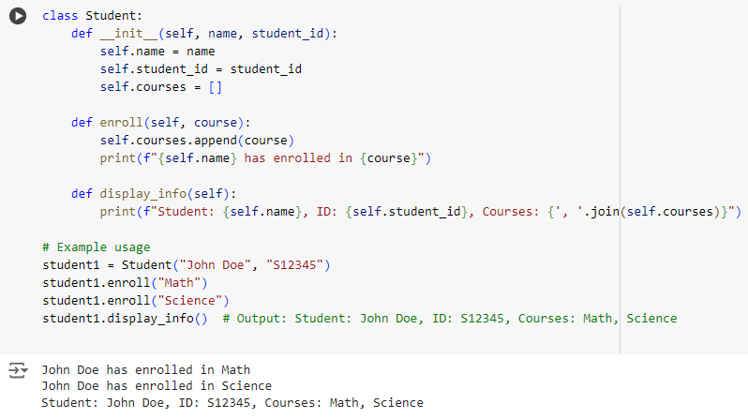
Creating a Student Management System
The Student class allows creating student objects with a name and ID. The enroll method adds courses to the student's list, and display_info shows the student's details.

Slide 17
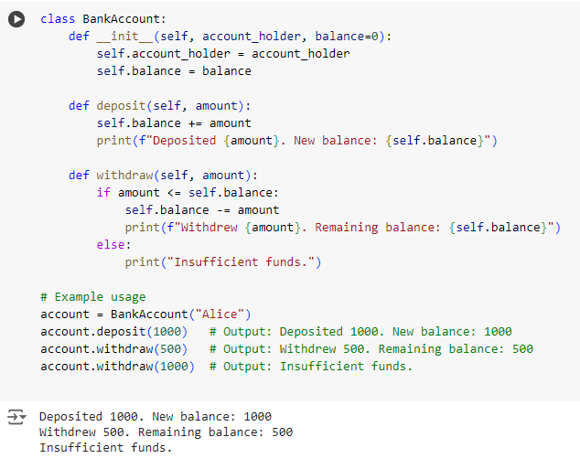
Modeling a Bank Account
The BankAccount class simulates a bank account with methods to deposit and withdraw money, while ensuring that withdrawals do not exceed the account balance.

Slide 18
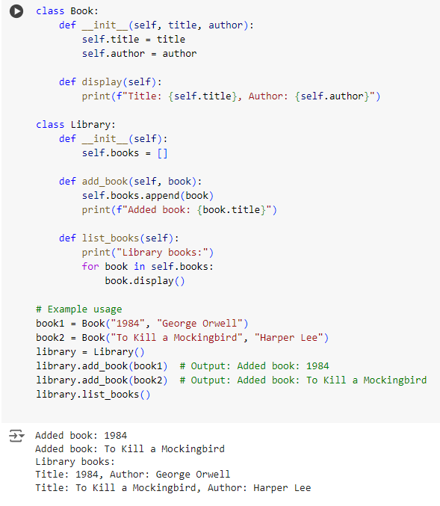
Modeling a Simple Library System
The Book class represents a book with a title and author. The Library class manages a collection of books, allowing books to be added and listed.

Slide 19
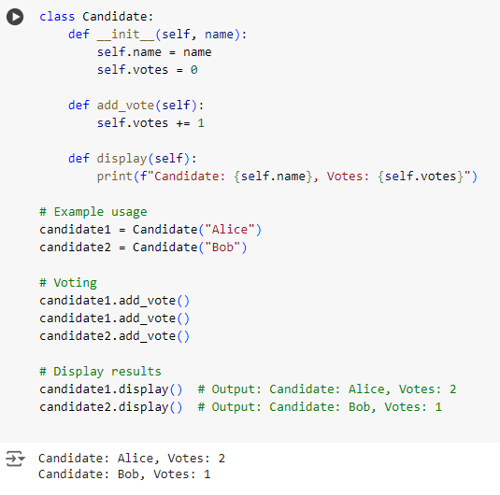
Simple Voting System
The Candidate class models a candidate in a voting system, tracking the number of votes received. The add_vote method increments the vote count, and the display method shows the candidate's details.

Slide 20
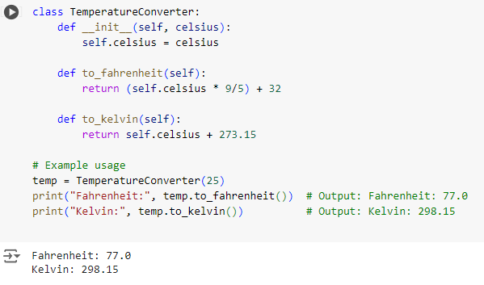
Simple Temperature Converter
The TemperatureConverter class converts a temperature in Celsius to Fahrenheit and Kelvin using methods to_fahrenheit and to_kelvin.

Slide 21
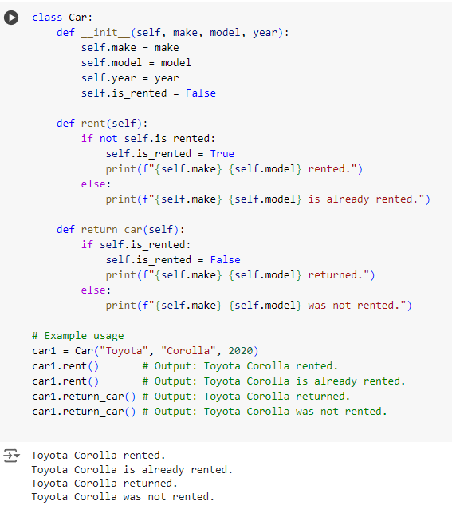
Modeling a Car Rental System
The Car class models a car in a rental system, with methods to rent and return the car, managing its availability state.

